Slide 1


GIT ASSIGNMENT
:GROUP 12

Slide 2
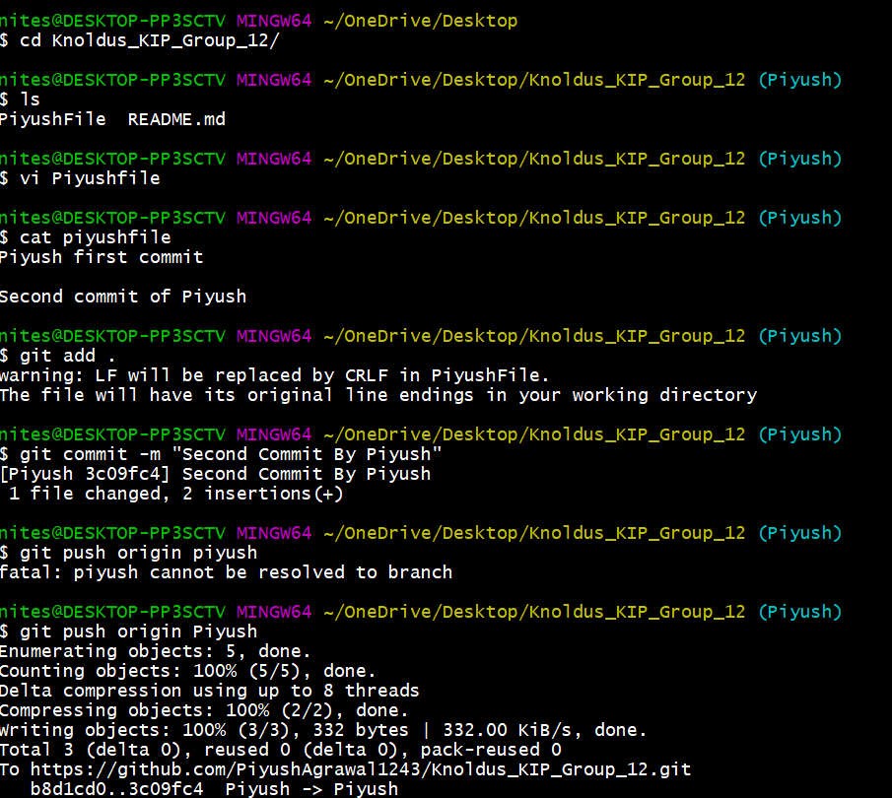
Piyush

